Slide 1
















NICE
NAVIGATING INTERPERSONAL COMMUNICATIONS & EMOTIONS
An Interactive Workshop

Slide 2






In Our Feelings
Emotions profoundly impact workplace communication, shaping how individuals communicate, interpret messages, and engage with colleagues, impacting overall mood and performance.

Slide 3

WHY NAVIGATE INTERPERSONAL COMMUNICATION AND EMOTIONS?
Understanding how to navigate (recognize, understand, and manage) your own emotions as well as being mindful of others’ emotions can assist in developing a positive workplace culture.
NICE offers an opportunity to look inwards and reflect upon growth and cognitive reactions when emotions come into place.

Slide 4






HOW ARE YOU FEELING ABOUT NICE?

Slide 5



EMOTIONS EFFECT COMMUNICATION
Positive
Negative
Emotions like happiness, excitement, and gratitude can build trust and stronger relationships, leading to more open and honest communication. They also enhance social connection, communication abilities, and even physical health.
Emotions like stress, anger, and fear can cloud judgment and make it difficult to express oneself clearly or understand others' perspectives. This leads to misunderstandings, conflicts, and even physical reactions. They damage relationships, reduce trust, and decrease the willingness to engage in open communication.

Slide 6

Quote
A lack of communication breeds assumption of what the other person is thinking or feeling…and assumptions are, more often than not, incorrect.

Slide 7





WORKPLACE CONFLICT
There are many reasons why conflict can arise in the workplace:
Personality clashes
Poor communication
Unclear job roles
Workload imbalance
Discrimination
Creative differences
Micromanagement
Conflicts of interest
Past unresolved issues
Conflict can significantly impact the workplace environment and employee well-being.

Slide 8




a
Effective communication is a core component of professionalism, enabling clear, respectful, and constructive interaction with colleagues and superiors.
PROFESSIONALISM
Being professional in the workplace is being reliable, setting high standards, and showing care about every aspect of the job.
Find your “WHY” by reflecting on your values and passions, consider the role you play in the organization, and look for opportunities to contribute to something meaningful.

Slide 9
MISSION
VISION
Café LA accomplishes this through various meal programs, multiple student-approved menu choices that provide healthy nutrients and energy to support the academic and physical growth of children.
“Nourishing Students to Achieve Excellence”

Slide 10

POSITIVE IMPACTS OF NOURISHMENT
Follow through of our division’s mission is most important to our students.
ENHANCED FOCUS & ATTENTION
BETTER ACADEMIC PERFORMANCE
REDUCED ABSENTEEISM
less likely to be absent or suspended from school due to issues or behavioral problems
better able to focus and concentrate, leading to improved learning outcomes
higher grades, better test scores and increased likelihood of graduation
THIS IS WHY! ALWAYS REMEMBER THE WHY!

Slide 11
Emotional Intelligence
EQ is the ability to understand, use, and manage your own emotions in positive ways to relieve stress, communicate effectively, empathize with others, and navigate challenges. Developing emotional intelligence can improve relationships, communication, and problem-solving skills.

Slide 12


5 Key Concepts
01
Social Skills
04
Self Regulation
02
05
Motivation
Self Awareness
03
Empathy

Slide 13




01
SOCIAL SKILLS
Effectively communicating and interacting with others,
building strong relationships, navigating social situations effectively.

Slide 14



GOOD COMMUNICATION IS THE BRIDGE BETWEEN CONFUSION AND CLARITY

Slide 15

BUILD STRONG RELATIONSHIPS
Social skills are the foundation for building and maintaining healthy relationships, both personally and professionally.
Being able to interact with others is important, especially in time of conflict or stress. Skills such as active listening and using verbal and non-verbal communication allows you to build meaningful relationships. This will develop a stronger understanding of yourself and others.

Slide 16




CHARACTERICTICS OF STRONG SOCIAL SKILLS
Establishes connections with staff
Has a strong rapport with leaders and colleagues

Slide 17
HOW TO IMPROVE SOCIAL SKILLS
ASK OPEN-ENDED QUESTIONS
PRACTICE GOOD EYE CONTACT
SHOW INTEREST IN OTHERS
START CONVERSATIONS
ACTIVELY LISTEN
NOTICE OTHER’S SOCIAL SKILLS

Slide 18


02
SELF-AWARENESS
Recognizing and understanding one’s own emotions and how they influence thoughts and behaviors.

Slide 19



I CANNOT CONTROL WHAT OTHERS DO OR SAY

Slide 20

Deconstructing Emotions
ARTICULATE
PHYSICAL MANIFESTATIONS
MASTER IT
Keep track of your emotions by writing it down.
Ask yourself:
  What am I feeling?
  When did I start feeling that way?
  What caused this feeling?
Gain the ability to harness the emotions and apply them to certain tasks. Manage the emotions.
Define the emotions, then tailor your reactions to various situations.
Anxious - heart race, chest constrict, or sweaty palms
Angry - feel hot, blood rushing to face, clenched teeth
Sad - physically heavy and exhausted

Slide 21
EMOTIONAL LITERACY
Emotional literacy refers to the range of words a person uses to describe their feelings and the feelings of others. This is crucial for emotional intelligence, allowing for clearer self-expression in communication, understanding of others, and healthier relationships, which in turn creates positive workplace cultures.

Slide 22

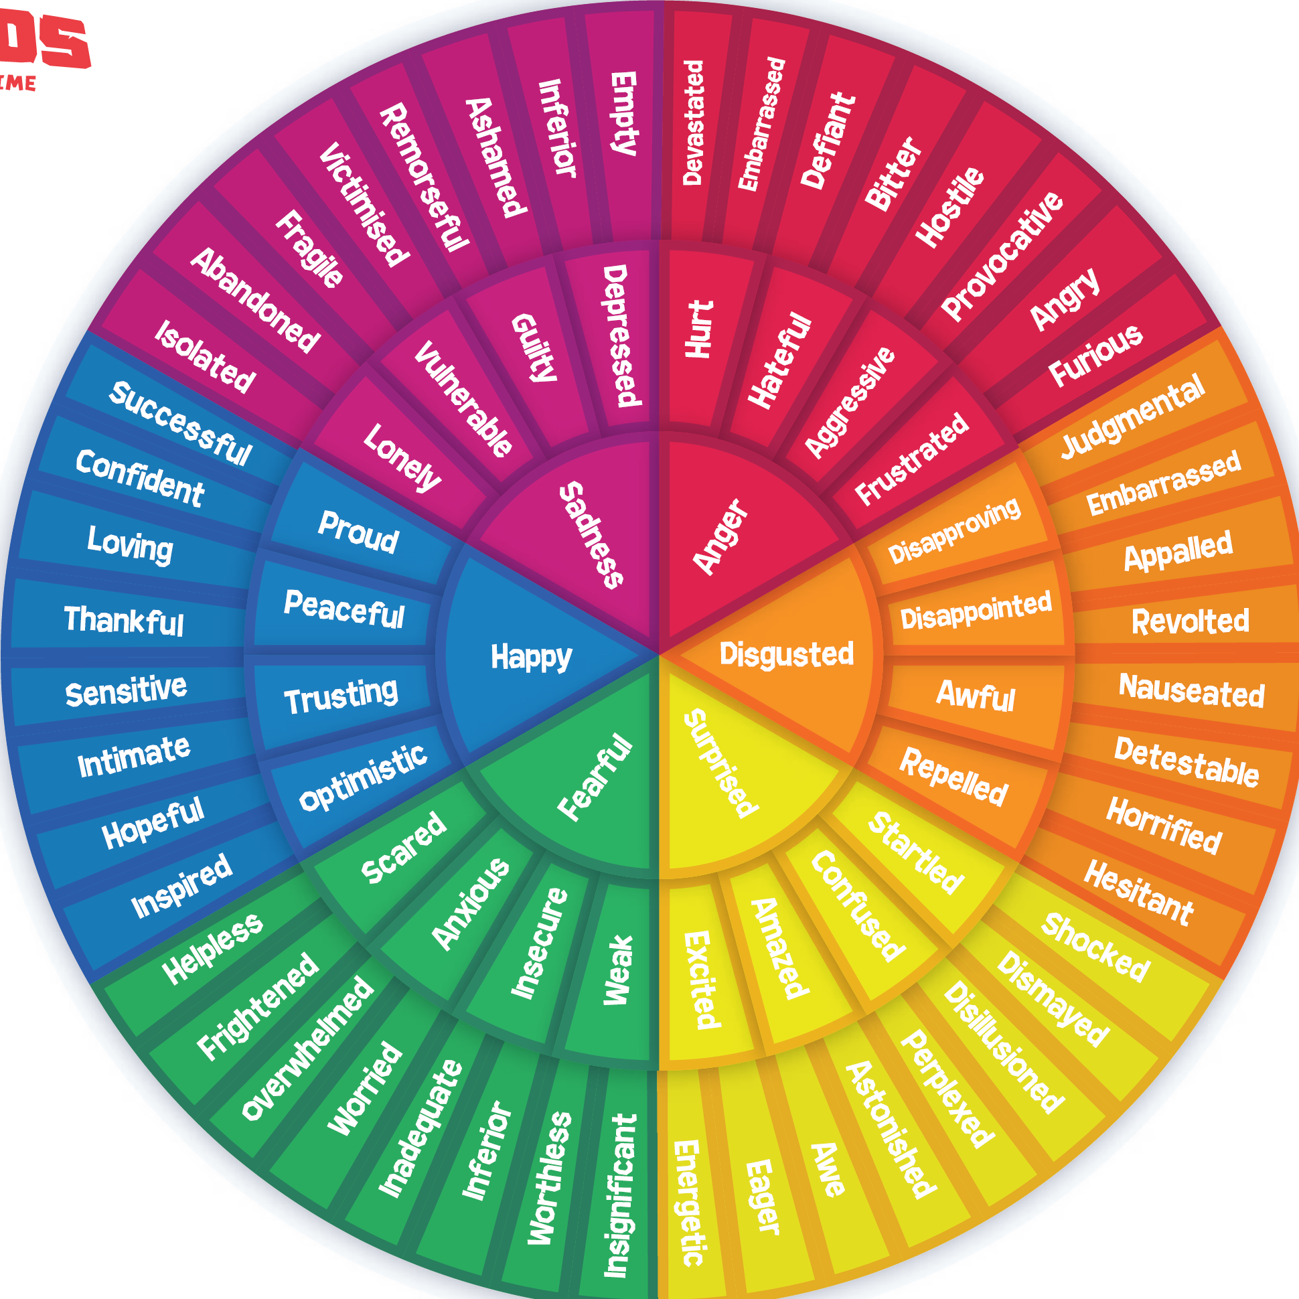
EMOTIONAL WHEEL
An emotional wheel helps you identify and understand your emotions by categorizing them into different levels of intensity and relatedness. It allows you to pinpoint exactly what you are feeling, and studies show that putting your feelings into words makes them easier to manage and cope with.

Slide 23
CHARACTERICTICS OF STRONG SELF-AWARENESS
Recognizes personal strengths and limitations
Open to new information and experiences
Learns from interactions with others
Possesses a good sense of humor and confidence

Slide 24
HOW TO IMPROVE SELF-AWARENESS
ASK FOR FEEDBACK
KEEP A JOURNAL
PAY ATTENTION TO THOUGHTS
REFLECT ON EXPERIENCES
BUILD A GROWTH MINDSET
USE POSITIVE SELF-TALK

Slide 25




03
EMPATHY
Understanding and sharing the feelings of others, including recognizing their perspectives and needs.

Slide 26

YOU CAN ONLY UNDERSTAND PEOPLE, IF YOU FEEL THEM IN YOURSELF

Slide 27
CHARACTERICTICS OF STRONG EMPATHY
Senses who possesses power in a relationship
Understands impacts of a person’s feelings and behaviors
Interpret situations that hinge on power dynamics

Slide 28
HOW TO IMPROVE EMPATHY
BE WILLING TO SHARE FEELINGS
ENGAGE IN CAUSE, COMMUNITY PROJECTS
LISTEN TO OTHERS
IMAGINE YOURSELF IN OTHERS’ PLACES
TALK/MEET NEW PEOPLE
PRACTICE ACTS OF KINDNESS

Slide 29
04
SELF-REGULATION
Managing one’s emotions and impulses effectively, including the ability to delay gratification and resist negative impulses.

Slide 30


FEELINGS ARE LIKE WAVES, YOU CAN’T STOP THEM FROM COMING, BUT YOU CAN CHOOSE WHICH ONE TO SURF

Slide 31

EMOTIONAL REGULATION
Actively manage your emotions in the workplace!
IDENTIFY YOUR FEELINGS
USE
COPING MECHANISMS
RECOGNIZE TRIGGERS
PERFORM EFFECTIVELY DESPITE STRESSORS
RESPOND
CALM
AND APPROPRIATE
MAINTAIN A PROFESSIONAL DEMEANOR

Slide 32


REDUCE INTENSITY OF REACTIONS
NOT IN MY CONTROL
IN MY CONTROL
Past
Future
Opinions of others
What other people think of me
My Boundaries
My thoughts and actions
Goals I set
How I speak to myself
What I give my energy to
How I handle challenges

Slide 33
CHARACTERICTICS OF STRONG SELF-REGULATION
Strong self-discipline and self-control
Thoughtful of how they influence others
Take responsibility of their actions

Slide 34
HOW TO IMPROVE SELF-REGULATION
MANAGE DIFFICULT EMOTIONS
SEE CHALLENGES AS OPPORTUNITES
RECOGNIZE YOU HAVE A CHOICE IN REACTIONS
PRACTICE COMMUNICATION SKILLS
CHANGE THOUGHT PATTERNS AND RESPONSES
ACCEPT FEELING EMOTIONS

Slide 35


05
Using emotions to drive oneself toward goals and overcome challenges, including maintaining a positive attitude and persistence.
MOTIVATION

Slide 36

EMOTIONS CAN GET IN THE WAY, OR GET YOU ON THE WAY

Slide 37

LEARN SOMETHING NEW
New experiences can stimulate your brain and increase dopamine, which is associated with pleasure and motivation. This leads to greater engagement and learning.
Motivation encompasses not just the desire to achieve, but also the drive to improve, take initiative, and persevere in tough moments.

Slide 38
CHARACTERICTICS OF STRONG MOTIVATION
Action oriented
Set goals
Obtain high need for achievement
Good at taking initiative
Always looking for ways to do better

Slide 39
HOW TO IMPROVE MOTIVATION
CELEBRATE WINS, EVEN SMALL ONES
SET SMALL, MEASUREABLE GOALS
INVITE/ACCEPT NEW CHALLENGES
REWARDS TAILORED TO YOUR INTERESTS
FOSTER ACCOUNTABILITY WITH A FRIEND
READ SELF-HELP BOOKS

Slide 40
POWER IN EMOTIONAL INTELLIGENCE
Emotional intelligence plays an important role in fostering a positive and productive workplace culture.
Those who embrace the 5 key areas and work towards a high EQ tends to lead to better communication, stronger relationships, and increased collaboration, all of which contributes to a more engaged and higher performing workforce.

Slide 41


Emotions impact the workplace and communication. Practicing NICE fosters a sense of shared purpose.
WHAT DID YOU LEARN?
1.
By mastering your emotions, we can reduce the intensity and duration of them in times of stress or conflict.
2.
Develop Emotional Intelligence (EI) by using its 5 key areas: social skills, awareness, empathy, regulation, and motivation.
3.
Remember “why” you are here and to always look inward to your values and goals and the role you play.

Slide 42

Thank you

